Slide 1
digitale dramenanalyse
sample workflow to a standard data set from historical sources Stephan Schwarz, FUB
Notes:
Only a dekblat
Introduction later
1. Few things bout me

Slide 2
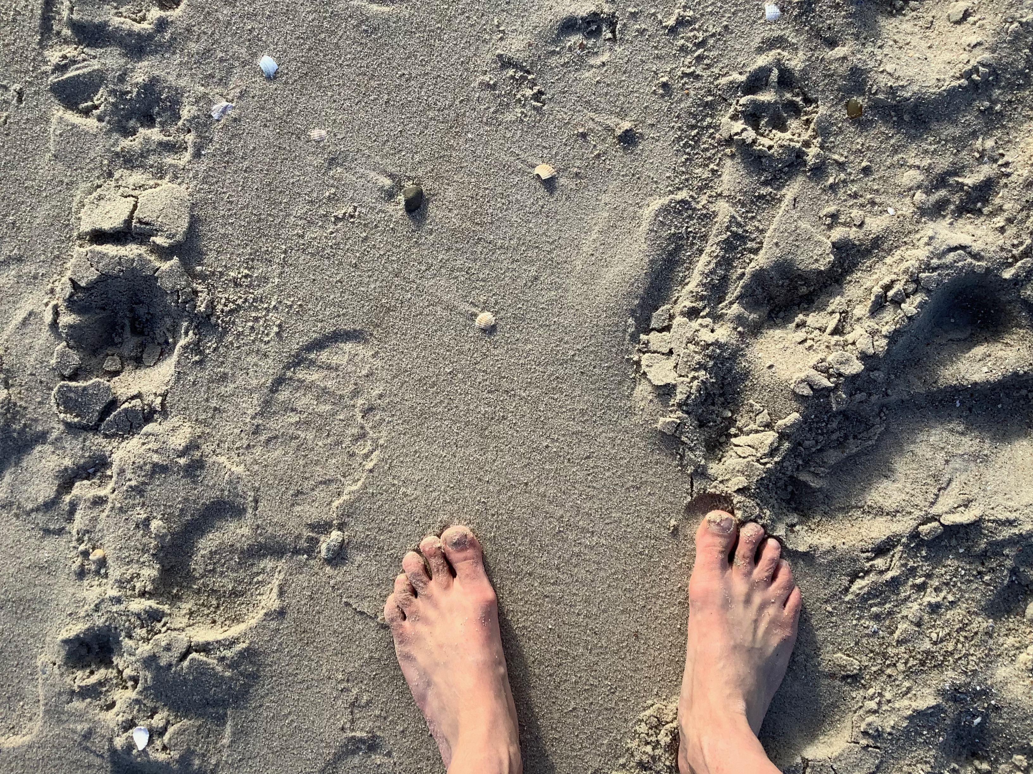
where:you:at

Slide 3
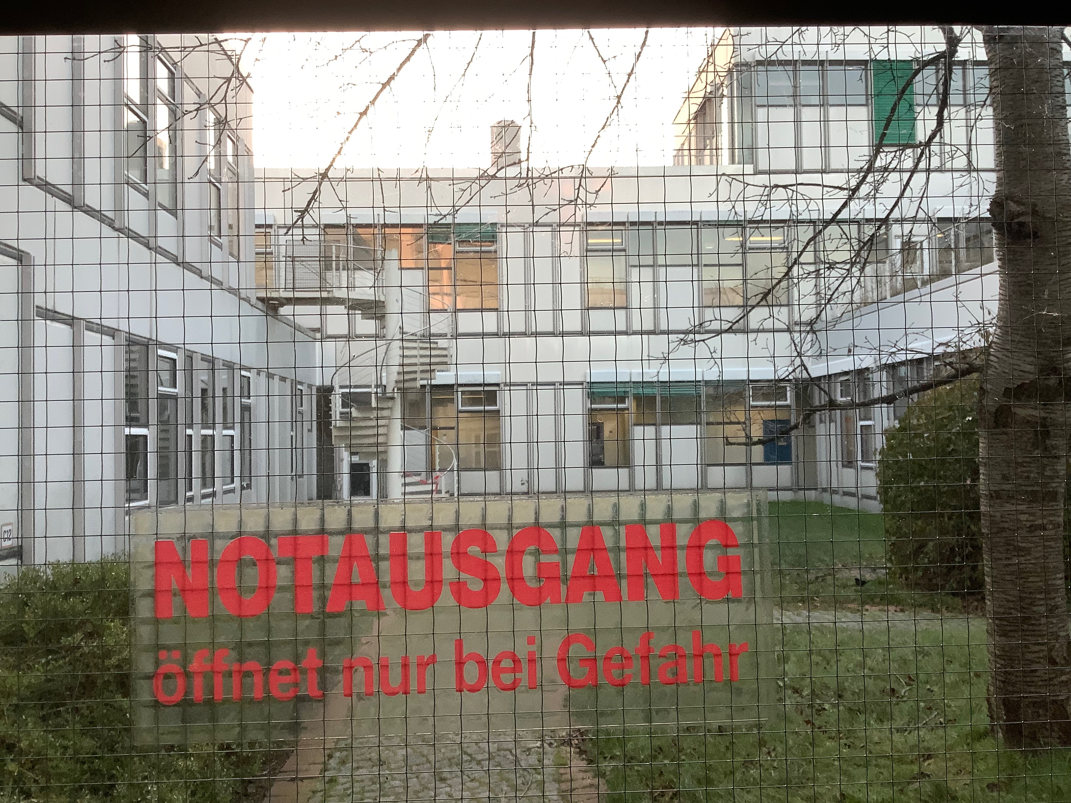
things i learned at school

Slide 4
intro
I will show you in a few steps an example workflow of how to produce standard documents of historical sources that enable further analysis of (here) dramatic text. assumed we start with a plain text file, a lot of work had been done by others yet and we can proceed to the TEI refactoring of the text. but with historical sources (wide sense) this will not be the case, so first will be to transcribe some source of the text, usually a .pdf or collection of .jpegs like the following…

Slide 5
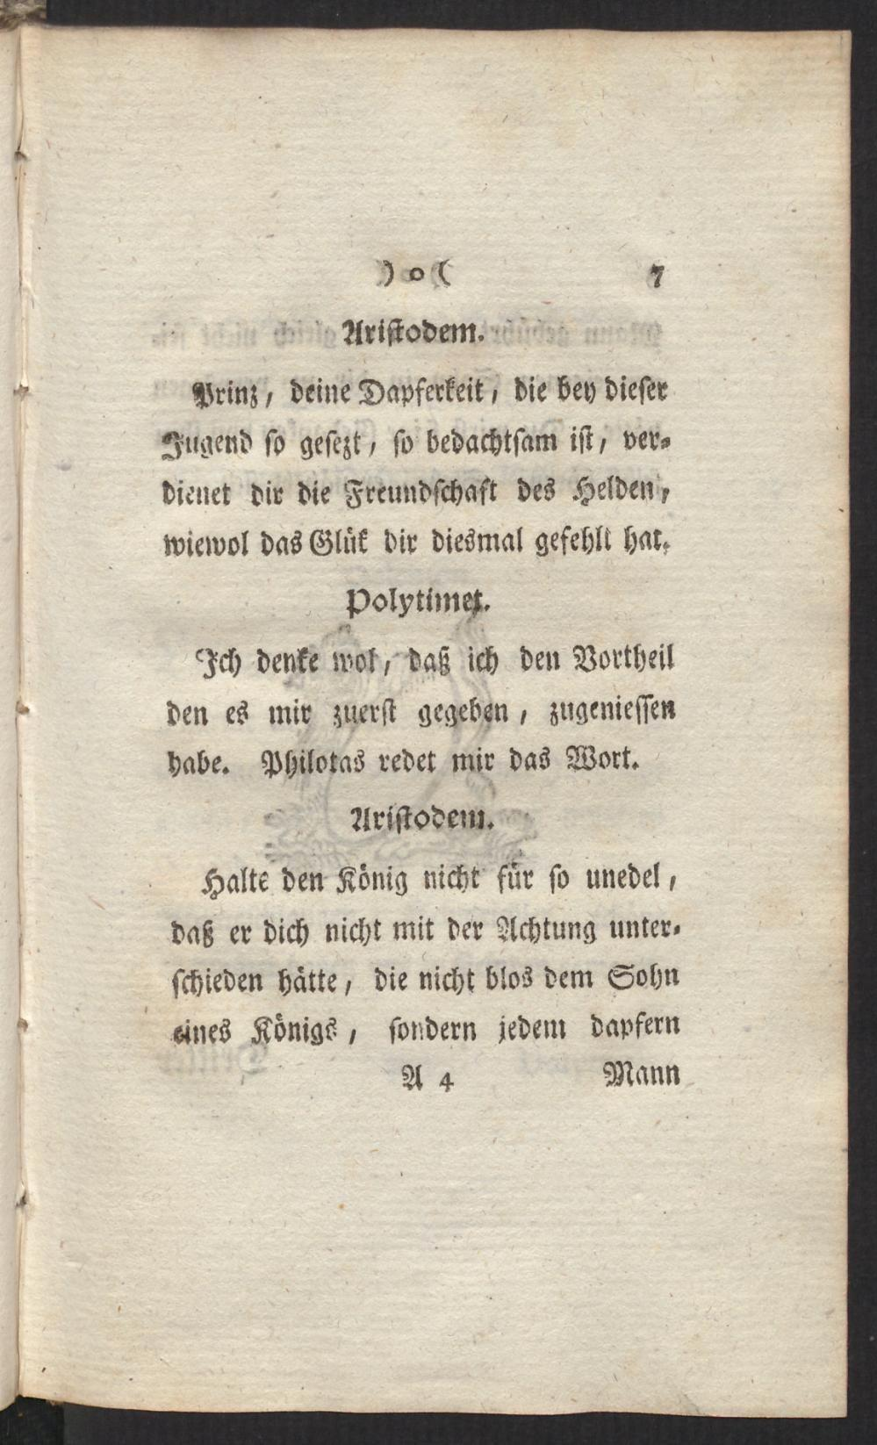
this:
bodmer: polytimet, excerpt

Slide 6
transcription
for that purpose you can either transcribe the text manually, from picture to text, or you use e.g. TRANSKRIBUS (read-coop 2022), a user friendly framework for OCR (optical character recognition). with that half of the work is done by the engine, but you still have to check the automatic transcription for recognition failures depending on the quality and the typography of the source.

Slide 7
editing
next step if you have the transcript ready would be to upload the text page by page to WIKISOURCE (Wikimedia n.d.) where it can be proofread by others. after that you can download the proper version of the text from which we proceed to the TEI.

Slide 8
TEI:why
FAIR-Prinzipien für Daten: findable, accessible, interoperable, reusable
TEI: text encoding initiative (TEI 1987)
theres multiple ways of how you can get to the TEI text. one is to wrap text elements which need to be marked up with OXYGEN, a powerful XML editor.

Slide 9
TEI:refactoring
in our drama class, we used a python notebook (ezdrama, Skorinkin, Trilcke, and Giovannini (2023)) written by a friendly geek which allowed easily transforming the preprocessed text into the desired format.

Slide 10
basic auszeichnung:
@title Ham @subtitle A tragedy @author William S ^Dramatis Personae Ham Egg Vikings #Act 1 ##Scene 1 @Ham: Lovely Spam! @Egg: Wonderful Spam! ##Scene 2 $Enter Vikings @Ham: Egg, Spam, Sausage, and Bacon! @Vikings (singing): Spam, Spam, Spam, Spam, Spam, Spam, Spam, and Spam $The end

Slide 11
finalise
if all that is done you possess a finalized TEI document which allows further analysis of the drama again e.g. using python or R for network, semantic etc. analyses. 1 platform hosting e.g. the drama plays in question is dracor.org (Fischer et al. 2019), from where you can access the TEI versions, network data and other data.

Slide 12
TEI excerpt
<div type="act"> <head>Zweyter Auftritt.</head> <stage>Aristodem, Polytimet.</stage> <sp who="#aristodem"> <speaker>Aristodem.</speaker> <p>Ich komme, den König Polemon bey dir zu melden; er wird gleich bey dir seyn.</p> </sp> <sp who="#polytimet"> <speaker>Polytimet.</speaker> <p>Was ist das für eine Herablassung, daß er zu seinem Gefangenen kommen will? Ich halte es für Edelmuth, und daß er mir so das Unglük, ein Gefangener zu seyn, versüssen wolle. <pb no="7"/>;</p> </sp> <sp who="#aristodem"> <speaker>Aristodem.</speaker> <p>Prinz, deine Dapferkeit, die bey dieser Jugend so gesezt, so bedachtsam ist, verdienet dir die Freundschaft des Helden, wiewol das Glük dir diesmal gefehlt hat.</p> </sp>

Slide 13
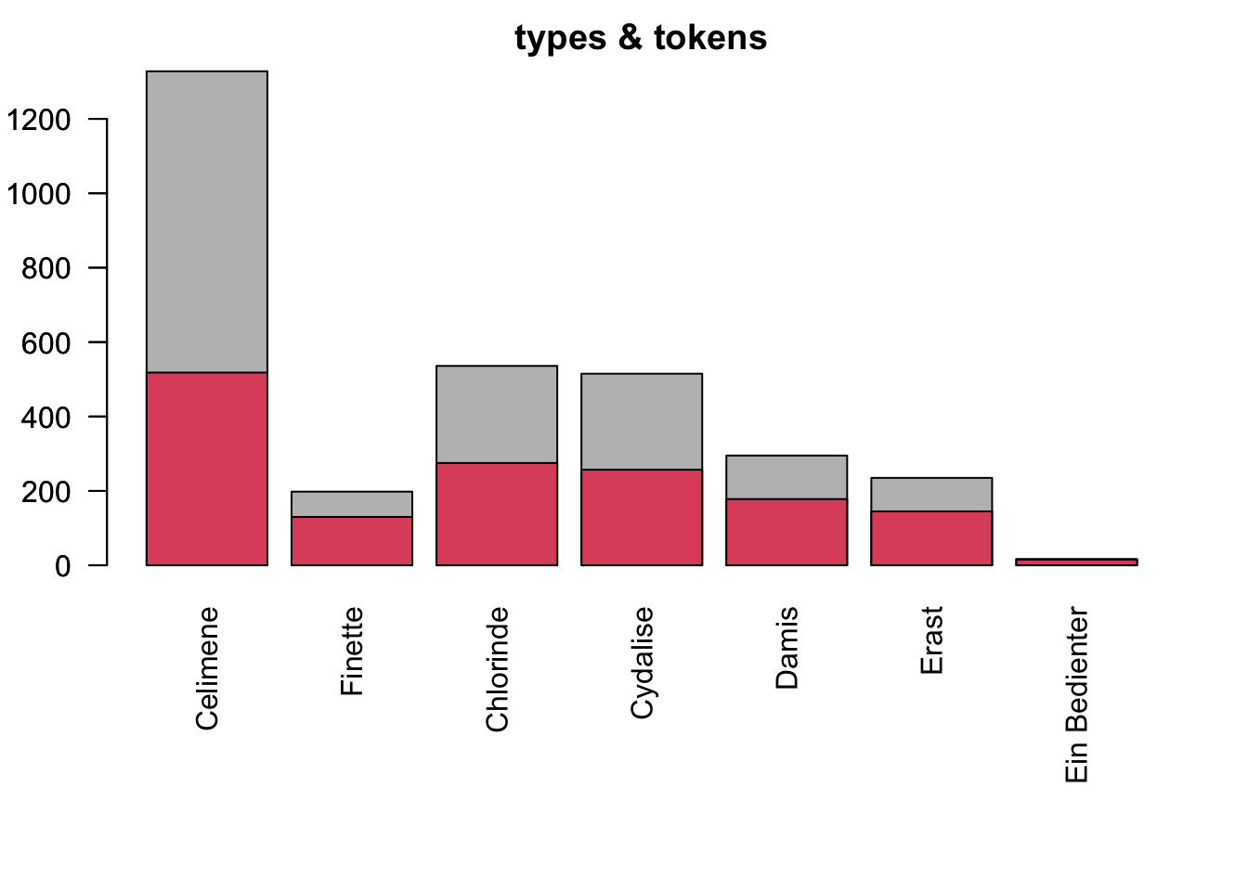
output1

Slide 14
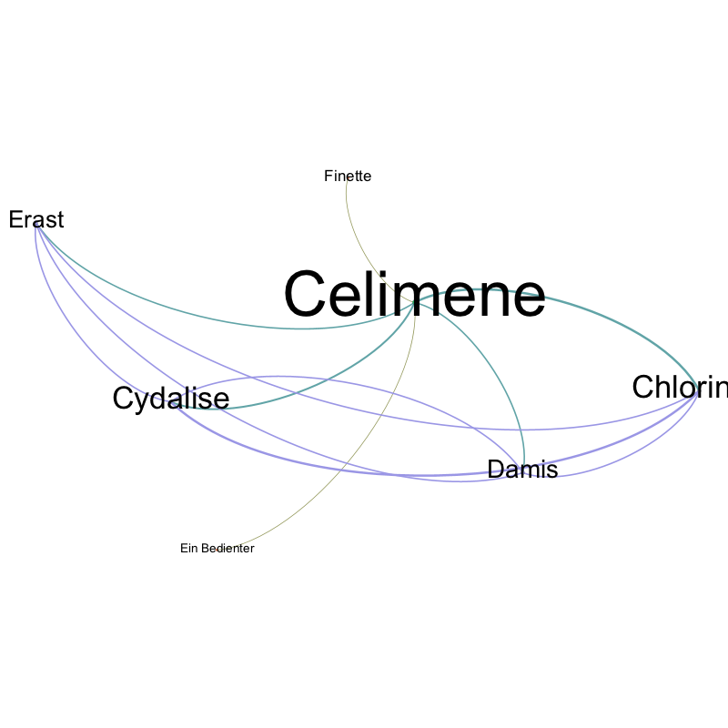
output2
“Gephi - The Open Graph Viz Platform” (n.d.)

Slide 15
e.g. LX basics
X | token | tag | pos | category | funct | case | pers | num | gender | tense | mode
1 | Klagen | N.Reg.Nom.Pl.Fem | N | Reg | NA | Nom | NA | Pl | Fem | NA | NA
2 | , | SYM.Pun.Comma | SYM | Pun | Comma | NA | NA | NA | NA | NA | NA
3 | nichts | PRO.Indef.Subst.-...Neut | PRO | Indef | Subst | NA | NA | NA | Neut | NA | NA
4 | als | CONJ.Comp.- | CONJ | Comp | NA | NA | NA | NA | NA | NA | NA
5 | Klagen | N.Reg.Nom.Pl.Fem | N | Reg | NA | Nom | NA | Pl | Fem | NA | NA
6 | ! | SYM.Pun.Sent | SYM | Pun | Sent | NA | NA | NA | NA | NA | NA

Slide 16
further processing
the standardised text opens more options - building a corpus of the text/texts in question: ANNIS (“ANNIS (Corpus-Tools.org)” n.d.) - annotating/coding the text (corpus) - textwitness comparison, LERA (Pöckelmann et al. 2022)

Slide 17
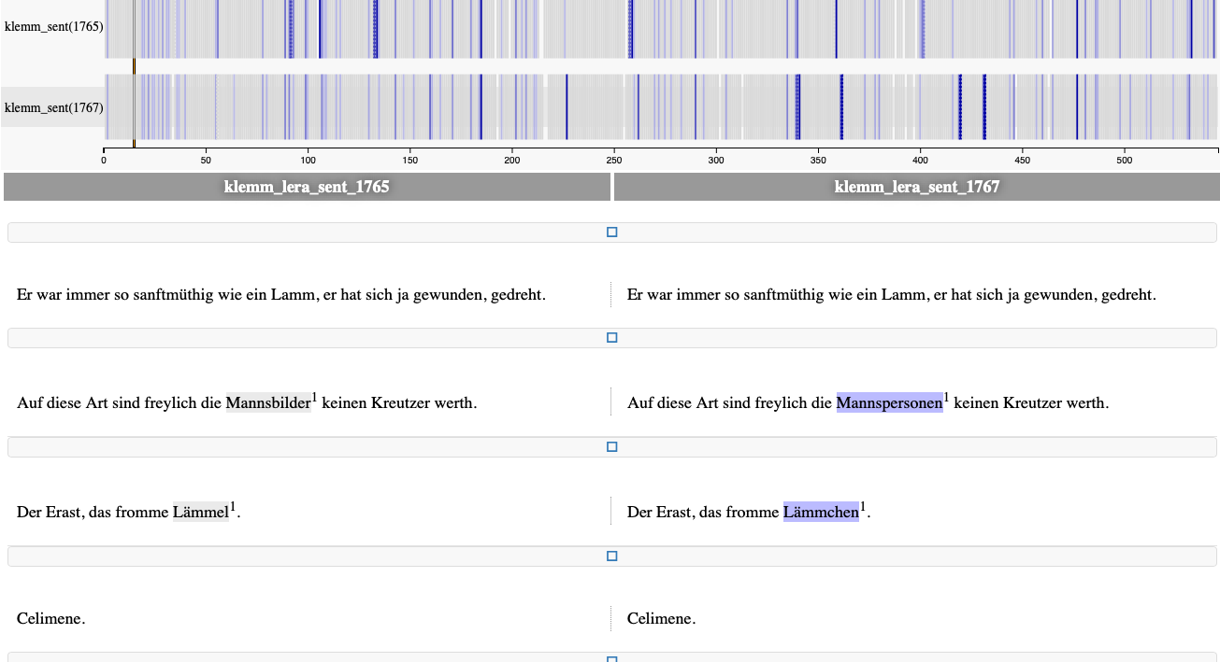
sources comparison
LERA output

Slide 18
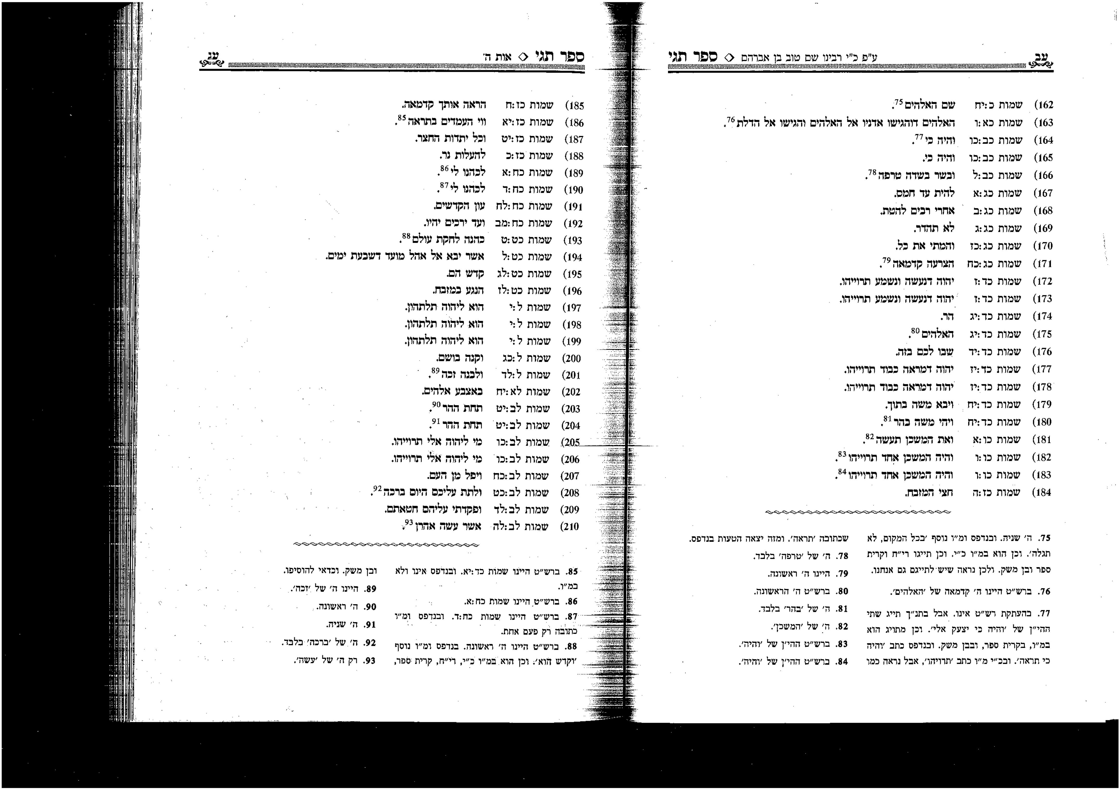
todo
ספר תגי

Slide 19
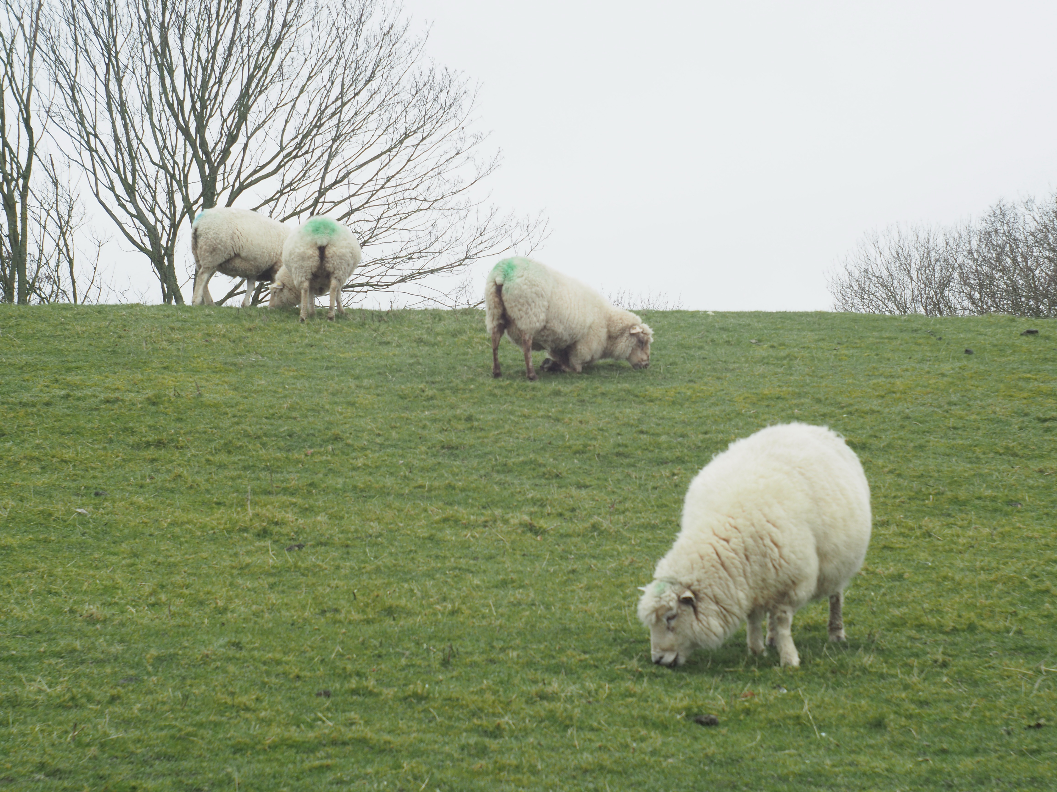
19

Slide 20
“ANNIS (Corpus-Tools.org).” n.d. Accessed July 22, 2023. https://corpus-tools.org/annis/.
Fischer, Frank, Ingo Börner, Mathias Göbel, Angelika Hechtl, Christopher Kittel, Carsten Milling, and Peer Trilcke. 2019. “Programmable Corpora: Introducing DraCor, an Infrastructure for the Research on European Drama.” Utrecht. https://doi.org/10.5281/zenodo.4284002.
“Gephi - The Open Graph Viz Platform.” n.d. Accessed July 22, 2023. https://gephi.org/.
Pöckelmann, Marcus, André Medek, Jörg Ritter, and Paul Molitor. 2022. “LERA - An Interactive Platform for Synoptical Representations of Multiple Text Witnesses.” Digital Scholarship in the Humanities (DSH). https://lera.uzi.uni-halle.de/about?lang=de.
read-coop. 2022. “Transkribus.” READ-COOP. https://readcoop.eu/transkribus/.
Skorinkin, Daniil, Peer Trilcke, and Luca Giovannini. 2023. “EzDrama.” DraCor. https://github.com/dracor-org/ezdrama.
TEI. 1987. “History – TEI: Text Encoding Initiative.” https://tei-c.org/about/history/.
Wikimedia. n.d. “Wikisource.” Accessed July 22, 2023. https://de.wikisource.org/wiki/Hauptseite.

